Slide 1

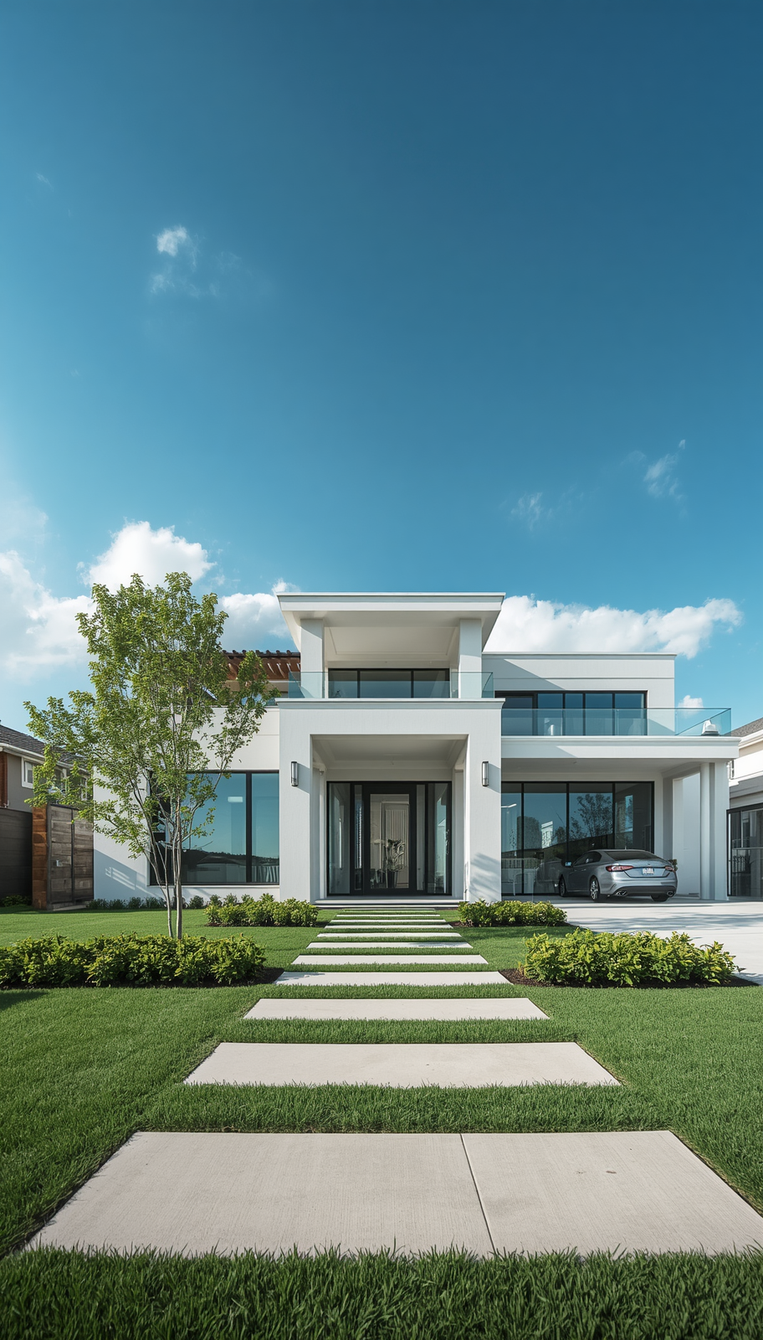

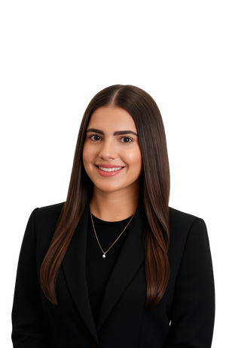
LISTING MARKETING PLAN
(Post-MLS Launch)
Your Complete Guide to Maximum Property Exposure
8943 HILDRETH AVE,
ORLANDO FL, 32832
SCHEDULE
Week 1: Launch Blitz
Week 2: Exposure Expansion
VALERIA HERNANDEZ
Week 3: Targeted Marketing
Ongoing Strategy Until Sold
REALESTATE@VALERIABH.COM

Slide 2
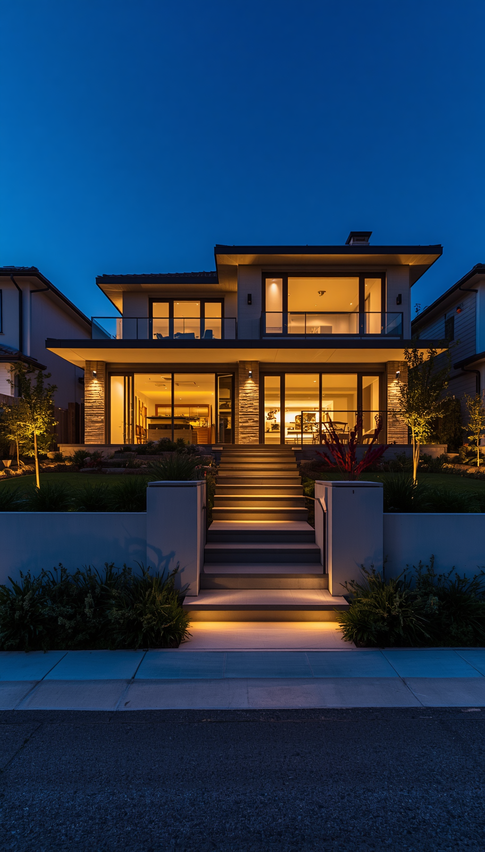










Social Media Launch (Same Day)
Post across all platforms:
Instagram
  Reel (property walkthrough)
  Carousel (top features)
  Story with poll (“Would you live here?”)
Facebook
  Full listing post + link to MLS
  Share in:
    Local community groups (Nextdoor)
    neighborhood groups (Whatsapp)
PLATFORMS WHERE YOUR LISTING WILL BE SHARED
MARKETING CHECKLIST
✔ MLS live
✔ Social media launch
✔ Email Marketing to agent network
✔ Open house scheduling & advertising
✔ Ads campaign running

